Slide 1
Sentiment Modeling
Using what people say to predict where a stock will go.
Presented by “The Sentimentalists”
Alex Smith, Andrew Altman, Joe Geoghegan, Krista Xhoxhi, and Lauren Krohn
Notes:
Joe

Slide 2
Data Sources
We used/looked into | By using these API
Stock data | Alpaca
10-K and 10-Q forms | sec-api
Reddit | pmaw
Twitter ¹ | Twitter
News Sources ¹ | news-api
¹ Due to subscription issues, we did not pursue these sources past initial data pulls
Notes:
Joe

Slide 3
Some Pitfalls of Analyzing Sentiment
Analyzing people can be dangerous
Think Cambridge Analytica
Sentiment Data Sources tend to be Subscription heavy
Knowing what someone is thinking is inherently valuable
Notes:
Joe
In the 2010s, personal data belonging to millions of Facebook users was collected, without consent, by Cambridge Analytica, and used for politically targeting

Slide 4

The SEC Edgar
Business Quarterly Reports are honestly awesome!
They have detailed financial data!
They clearly impact stock prices
They have explanations of what headwinds and tailwinds the company experienced!
Free, easy, and quick to download!
Too bad they are Government Documents…
They are stored as XBRL HTML files!
They have very little consistency between companies
They have very little consistency within the same company
They sometimes contain obvious errors
Super difficult to work with/analyze with code…
Notes:
Joe
https://www.sec.gov/news/press-release/2021-262 - JPMorgan Admits to Widespread Recordkeeping Failures and Agrees to Pay $125 Million Penalty to Resolve SEC Charges

Slide 5

r/stockmarket Comments
r/stockmarket is a forum dedicated to analysis of stocks, includes discussion of trading strategy
Approximately 1 million comments pulled, from 2012 to 2022 using PMAW library
Data sourced from Pushshift, an archive of Reddit data
PMAW uses multithreading to retrieve more comments, making multiple requests simultaneously on the Pushshift API to reduce impact of data limitations
Number of comments pulled per minute still limited despite advantages of PMAW
Notes:
Alex

Slide 6
Predicting Close Prices using LightGBM
Light Gradient Boosting Machine is a machine learning framework produced by Microsoft with a focus on performance
Generates sets of decision trees during training process
Cited as more performant alternative to random forests in most cases
Mean absolute percent error used as performance metric
Notes:
Alex

Slide 7
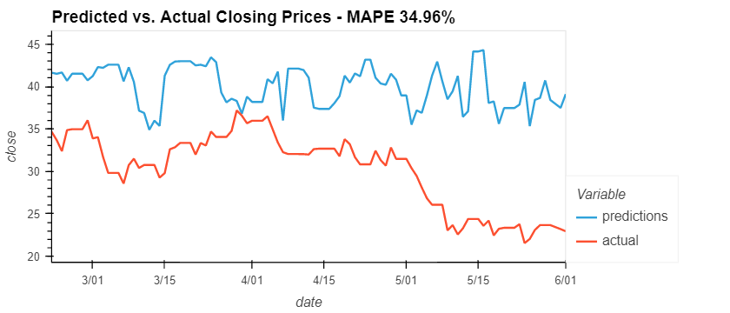
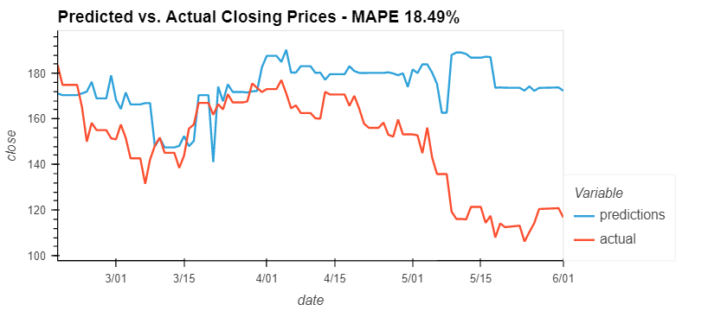
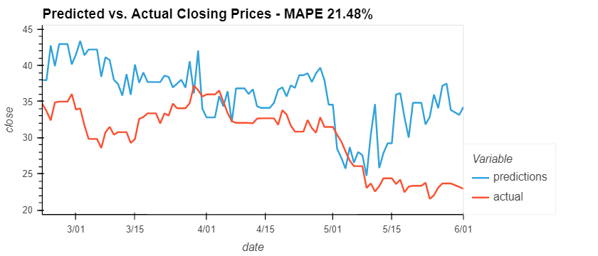
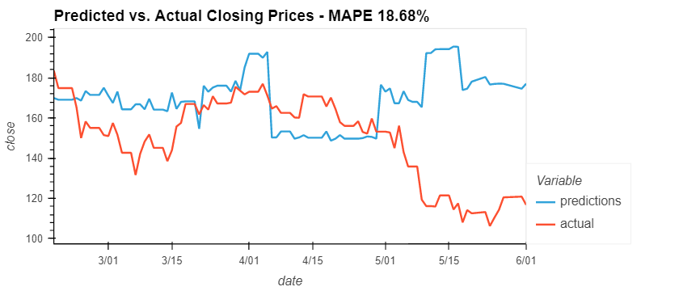
Uber with Sentiment and SEC Financials
AirBnb with Sentiment and SEC Financials
Uber with SEC and Reddit Sentiment
AirBnB with SEC and Reddit Sentiment
Notes:
Andrew/Alex

Slide 8
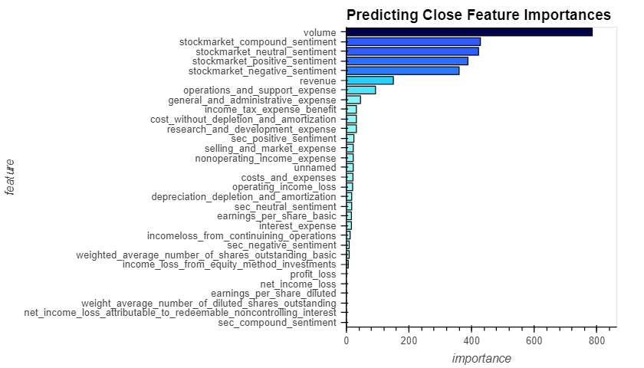
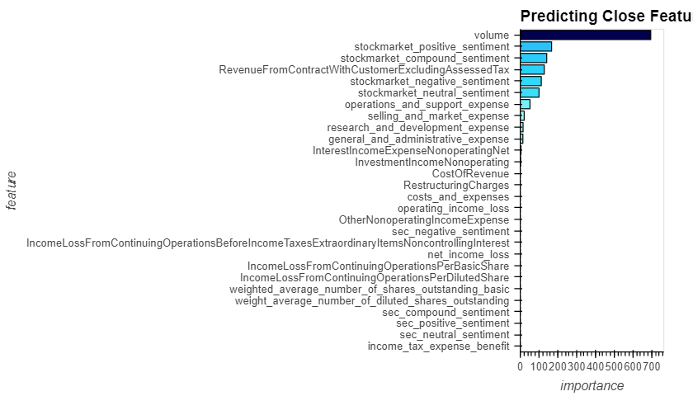
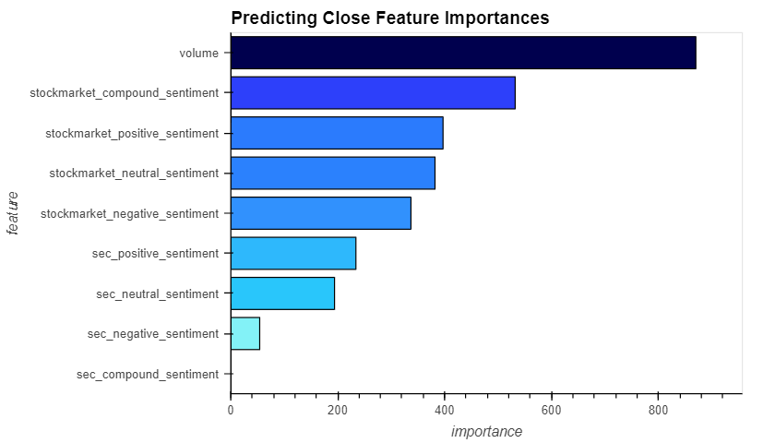
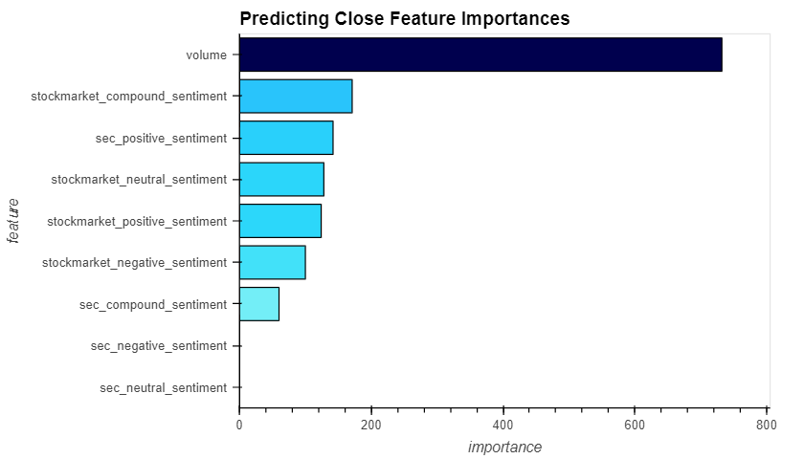
Uber
AirBnb
Notes:
Andrew/Alex

Slide 9
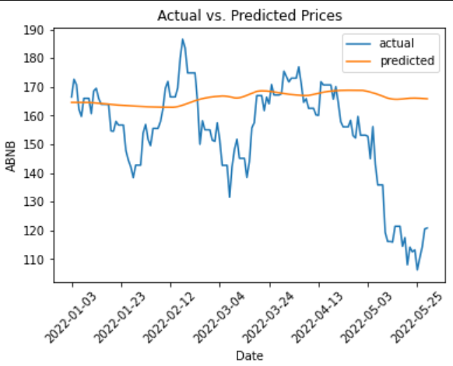
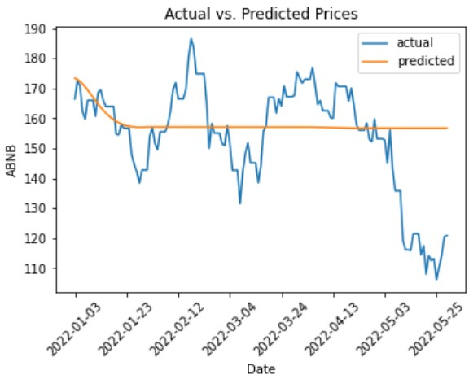
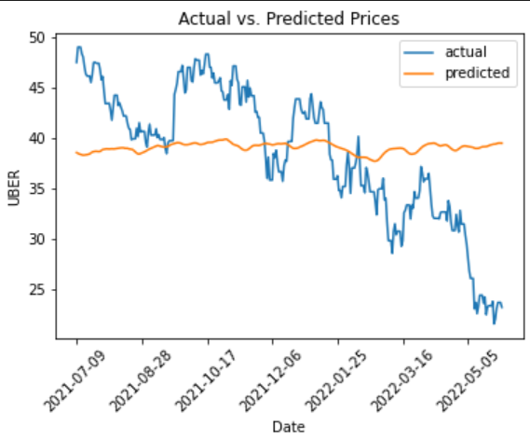
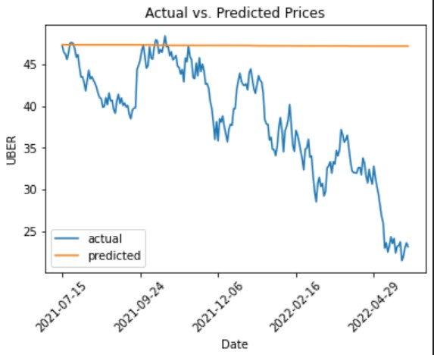
Predicting Stock Prices using LSTM - 1 Feature
Feature - Reddit Compound Feature - SEC Revenue
Notes:
Krista/Lauren

Slide 10
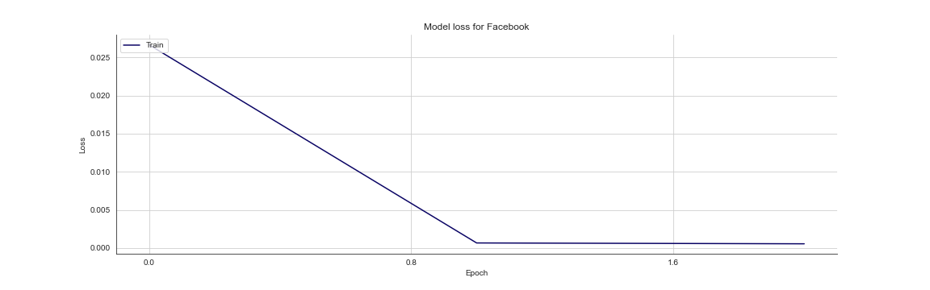
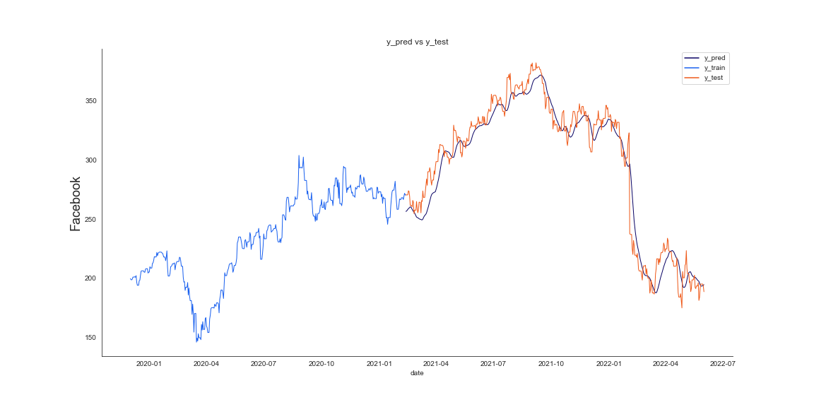
Facebook
Loss: 0.003
MAPE: 3.5%
Notes:
Lauren

Slide 11

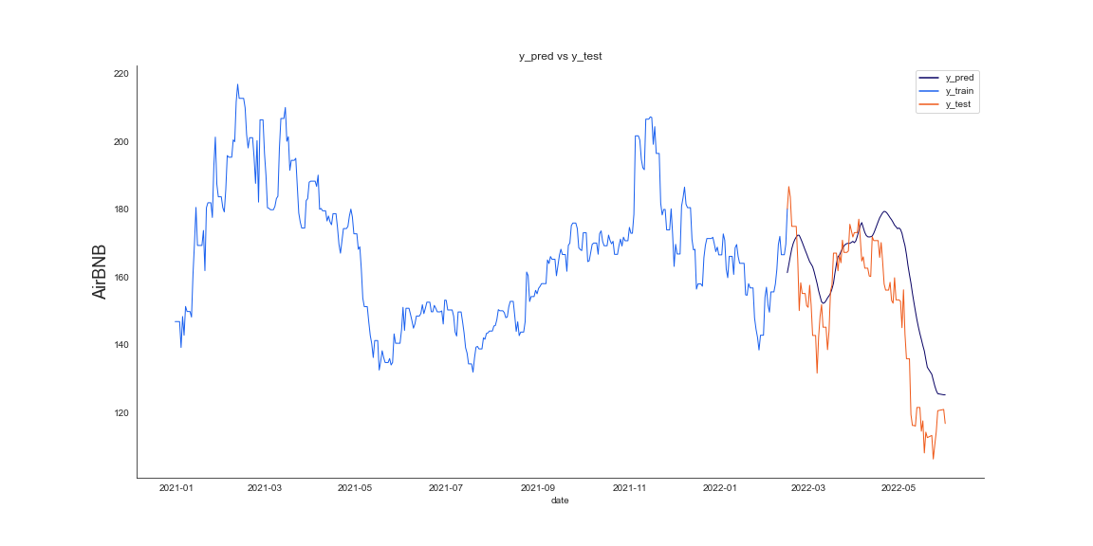
AirBNB
without SEC Financials
MAPE: 7.8%
Notes:
Lauren

Slide 12
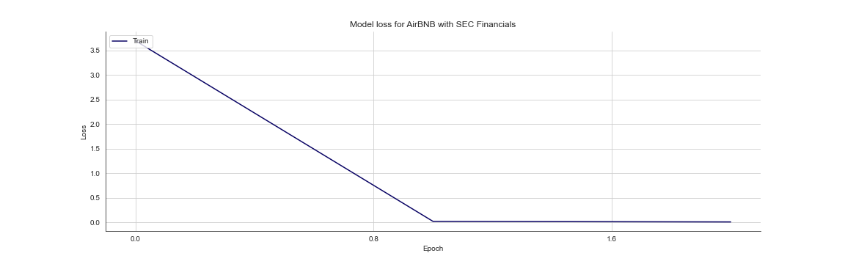
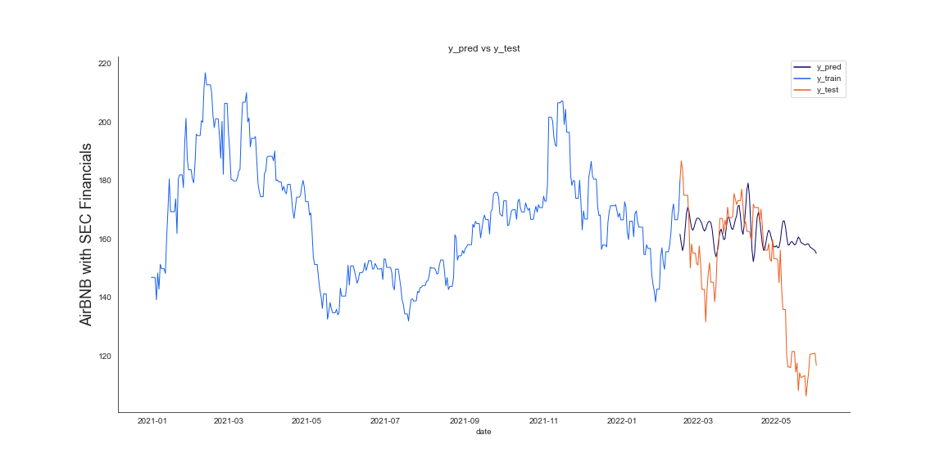
AirBNB
With SEC Financials
MAPE: 12.2%
Notes:
Lauren

Slide 13
Conclusions
Data Acquisition of Sentiment Data is difficult but there are rewards available if you can.
Compared to the financial statements of the SEC, the sentiment analysis tended to be a better predictor.
Sentiment is variable dependent on the stocks you are observing and the sources you are using.
The human element is a powerful tool but has its dangers.

Slide 14
Questions?

Slide 15
Thank you!

